Slide 1


Minor Project Presentation
Title: Quantum Ant Colony Optimization
for Solving Engineering Problems
Presented By:
Sk Mamud Haque
Roll No - R2142211466
Mentored By:
Dr. Hanumat Sastry G
Professor

Slide 2
Introduction
Literature Review
Objectives
Methodology
Working Model
References
Content

Slide 3
Introduction
Rapid technological advancements drive the pursuit of optimal solutions in engineering, focusing on design, efficiency, and performance enhancement.
Quantum Ant Colony Optimization (Q-ACO), a hybrid of quantum computing and swarm intelligence, is gaining popularity for tackling complex challenges.
Qubit-based quantum computing is revolutionizing traditional computer paradigms, holding potential for addressing intricate optimization problems.
Ant Colony Optimization (ACO), inspired by ant foraging behaviors, excels at quickly identifying near-optimal solutions, especially in challenging scenarios.
This project delves into Quantum Ant Colony Optimization, with a primary focus on structural topology optimization, a fundamental engineering challenge.
Leveraging the unique properties of quantum computing, such as superposition and entanglement, in conjunction with ant-inspired agents, aims to expand the boundaries of achievable optimized structural designs.
The project's primary objectives are twofold: first, to investigate the theoretical foundations of Quantum Ant Colony Optimization, particularly in the context of engineering challenges; and second, to provide practical insights for implementing Q-ACO, serving as a roadmap for engineers and researchers eager to harness quantum computing's power in optimizing structural designs.

Slide 4
Literature Review
Computers influenced by biology optimise structural topology. Shim and Manoocheer found the optimal structure using simulated annealing-based combinatorial optimisation.Component removal or restoration reduced finite element structural model volume while preserving stress. Area, perimeter, stiffness, and holes affect cantilever plate topology.Constrained mating, fitness sharing, cluster analysis. Graph theory allows vertices and undirected cubic Bézier curves.[8] GA graphs indicate costly geometry and global search. Optimisation of bit-array GA. Increase GA efficiency by improving design connectivity and constraint management.GA penalties reduce material and design and improve performance.
This research investigates quantum ant colony optimisation. Focus will be on structure topology optimisation, a key engineering difficulty. [3] This study uses ant-inspired animals' intelligence with quantum computing superposition and entanglement to improve structure design and engineering.This increases our options.[6] Present engineering and design prioritise structural topology optimisation. It permits creative and efficient arrangements in many fields. Its major goal is resource-efficiency, cost-effectiveness, and high-performance solutions by optimising material allocation within a design area under rigorous constraints.As companies grow and seek new engineering solutions, optimisation methods that quickly explore huge solution areas and use cutting-edge technology are needed.

Slide 5
Objective
Sub Objective
Create a method for topology optimisation based on quantum ant colony optimisation, often known as QACO.
Show that QACO is more effective at solving topological optimisation issues than traditional ant colony optimisation (ACO) techniques.
The QACO method should be implemented on a quantum computer or a quantum simulator.
Applying the QACO method to topology optimisation issues in the real world, such as the construction of lightweight and robust structures, may provide better results.

Slide 6
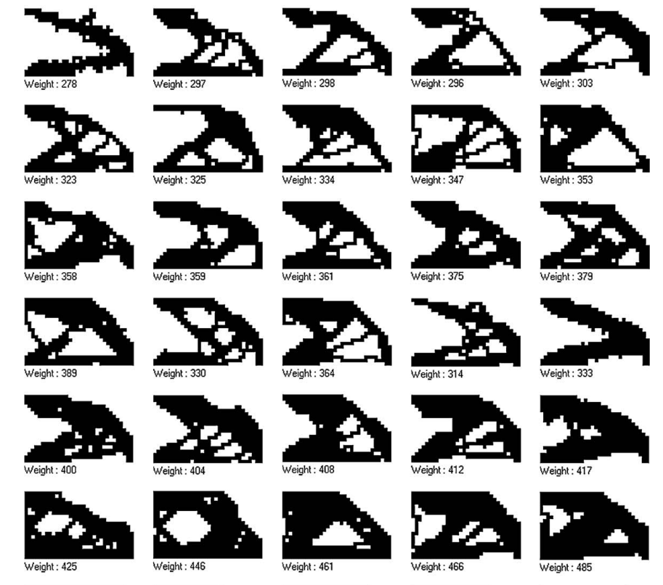
Working Model
Requirement analysis (Link of SRS) [LINK]
https://docs.google.com/document/d/1Ay7uhlmmpM_eUX4EQqHT4VD7L1ZntW0r/edit?usp=drive_link&ouid=111363271913671381628&rtpof=true&sd=true
fig - old output when we use only finite element analysis

Slide 7
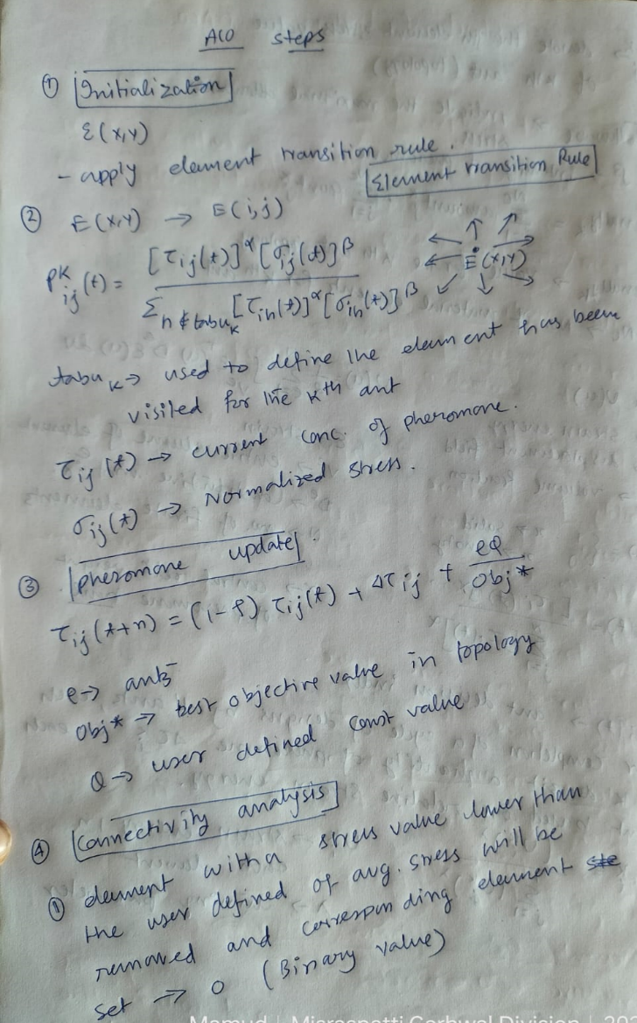
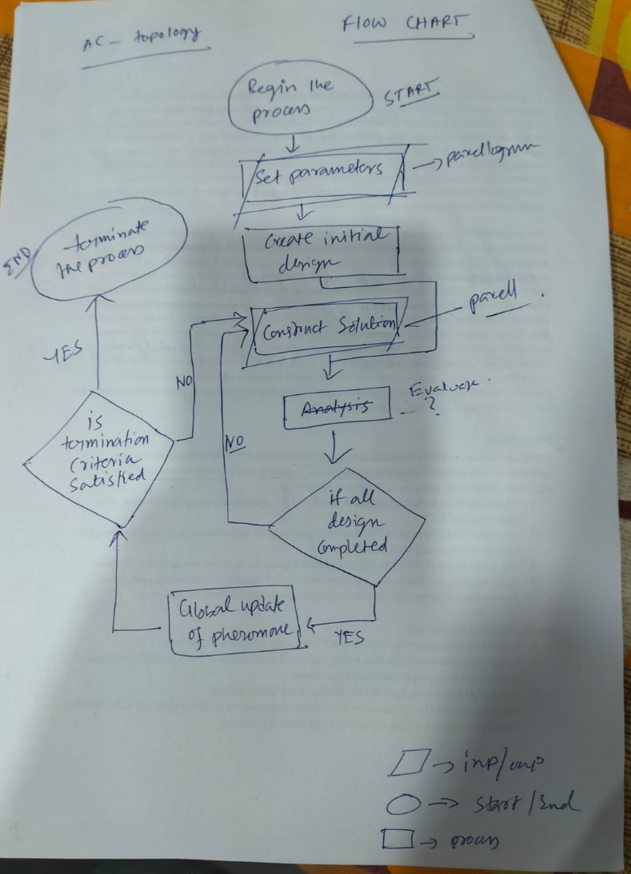
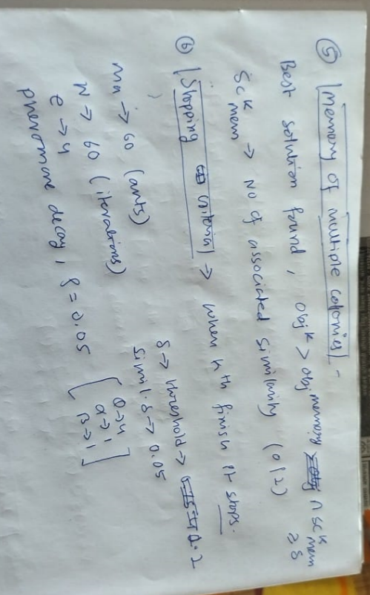
Working Model
Technical Diagram

Slide 8
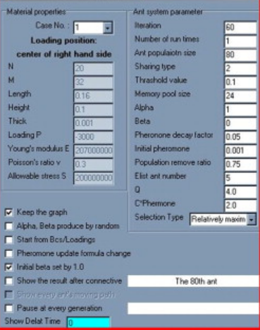
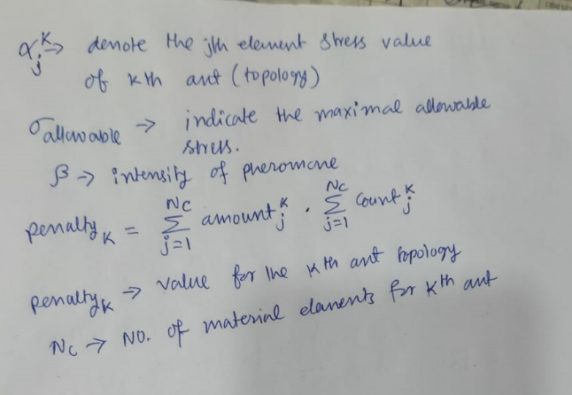
Working Model
Working Module

Slide 9
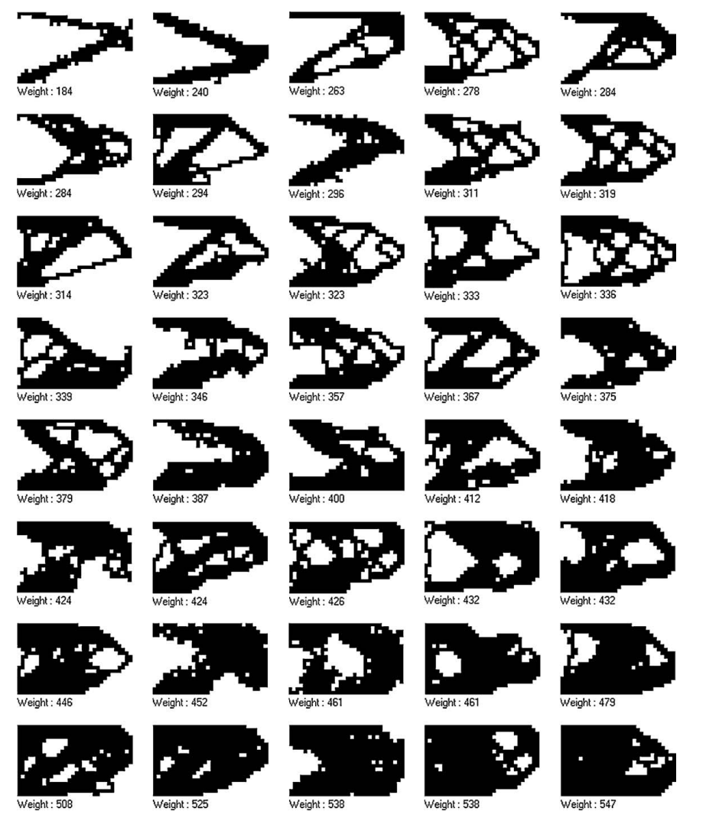
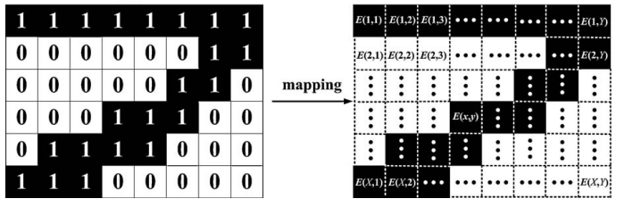
Working Model
Attained Deliverable
The elements where each ant has visited will be marked (material). The states of the individual elements define the distribution of material and void within the design domain.
After an ant finished it's tour, all the connecting elements (material) between loading regions and supporting regions of the structure establish a valid topology, physically meaningful connected structure. The resulting topologies trail intensity is determined according pheromone updating rule and thus a finite element analysis is performed on the topology.

Slide 10
Thank You

